Slide 1
Financial Incentives, Hospital Care, and Health Outcomes: Evidence from Fair Pricing Laws
Jingxuan Zhao
09/07/2022

Slide 2
Outline
Motivation
Questions
Fair Pricing Laws and Payment
Fair Pricing Laws and Treatment Pattern
Fair Pricing Laws and Quality of Care
Conclusion and discussion
Reflects

Slide 3
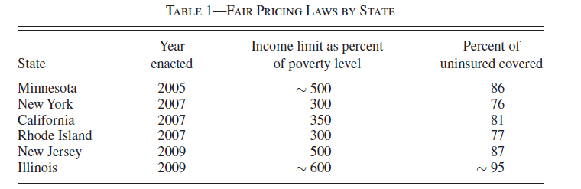
Motivation
Fair Pricing Laws (FPL): To limit how much uninsured patients pay hospitals (below an income cap).
Not all states adopted FPLs at the time of the study.
How hospital care and health outcomes respond to financial incentives.
Notes:
A study by Glenn Melnick and Katya Fonkychfound that by 2011 most California hospitals hadresponded to the law by adopting financial assis-tance policies to make care more affordable foruninsured patients.7Eighty-one percent of hos-pitals charged Medicare rates or less to un-insured patients with incomes below 350 percentof the federal poverty level. Thirty-two percent ofhospitals gave such discounts to uninsured pa-tients at or above 350 percent of poverty.

Slide 4
Study Questions
Payment
Fair Pricing Laws
Treatment pattern (Quantity)
Quality

Slide 5

Fair Pricing Laws and Payment (Part I)
Data: Medical Expenditure Panel Survey (MEPS), 2000-2004, Pre-FPLs
Nationally representative.
Monthly indictors of health insurance coverage (private, Medicaid, uninsured…) (24 in total for each person)
Health expenditure information, by type of service, by payment source
Other information: health condition, access to care, etc.
State is not publicly available.

Slide 6
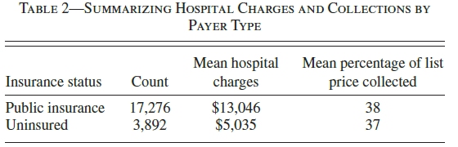
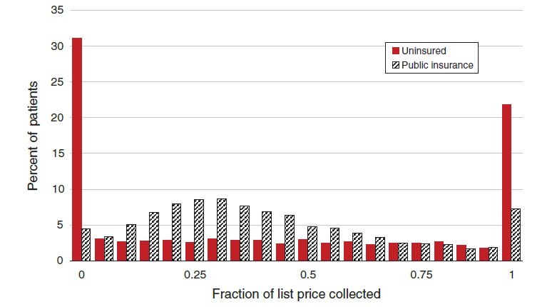
Fair Pricing Laws and Payment (Part I)
Study Sample
all patients with either public (control group) or no insurance in the MEPS between 2000 and 2004 who went to the hospital at least once

Slide 7
Fair Pricing Laws and Payment (Part I)
Statistical Methods
Compare payments from uninsured patients before and after FPLs.
How much FPLs would reduce payments
Match each uninsured patient with a publicly insured patient who has a similar bill size.
Cap collections from the uninsured at the percentage paid by the publicly insured.
Projected payments from uninsured patients fall by an average of 31 percent, or $1,800 per inpatient
Notes:
Ideally, we would use these data to compare payments from uninsured patients
before and after FPLs are enacted. Unfortunately, the number of uninsured patients
who have hospital expenditures in the MEPS is too small to perform this type of
state-level analysis

Slide 8
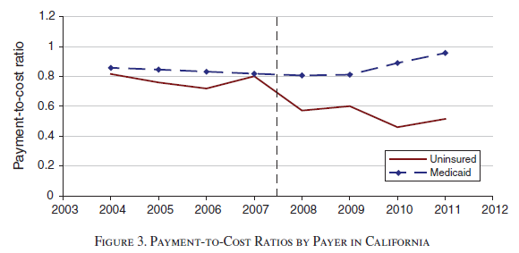
Fair Pricing Laws and Payment (Part II)
Data: California hospital financial data
Utilization and financial data
By payer category
All California hospitals
Study Sample: Medicaid (control group) and uninsured people
FPLs substantially reduce hospital prices for the average uninsured patient

Slide 9
Fair Pricing Laws and Treatment Pattern
Data
Nationwide Inpatient Sample (NIS)
The largest all-payer inpatient care database in the US
20% US acute care hospitals
California State Inpatient Database (SID)
All California admission
Notes:
For-profit hospitals are rare in our treatment states (primarily
due to state rules regarding hospital ownership), so we focus this analysis on
California where for-
profits are more common.
Studying procedures using the NIS is problematic due to data reporting inconsistencies,
26 but California reports this information consistently in their State Inpatient
Database.

Slide 10


Fair Pricing Laws and Treatment Pattern
For analysis using NIS
Treatment: states adopted FPL; control: states did not adopted FPL
For analysis using California SID
Treatment: uninsured people; control: Medicaid
Notes:
Empirical Framework

Slide 11
Fair Pricing Laws and Treatment Pattern
Primary outcome
Length of stay (LOS)
If FPLs will change the fraction of patients with a given insurance type and patient composition?
Notes:
First, it is an easily measured proxy for
resource use that has a consistent interpretation across hospitals and over time.
Furthermore, the large reductions in LOS that occurred after the introduction of
Medicare’s prospective payment system (which clearly introduced cost-
controlling
incentives) suggest that hospitals view length of stay as an important margin upon
which they can operate to control costs. Also, decreases in LOS are likely indicative
of other cost-
controlling behavior, like reductions in the amount, or intensity, of
treatment.
FPLs can be thought of as a type of catastrophic insurance, so they may induce
more people to go without insurance and/or more uninsured patients to seek treatment
at hospitals. Moreover, the reduced payments could lead hospitals to change
admission patterns of the uninsured. Any such changes would be important for
interpreting the results of our main analysis regarding the type and amount of care
delivered. To

Slide 12
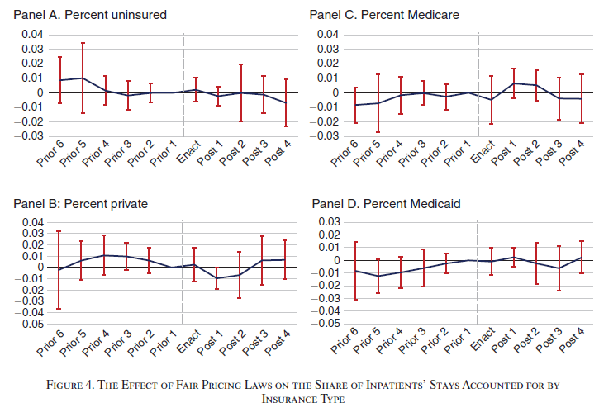
Fair Pricing Laws and Treatment Pattern

Slide 13
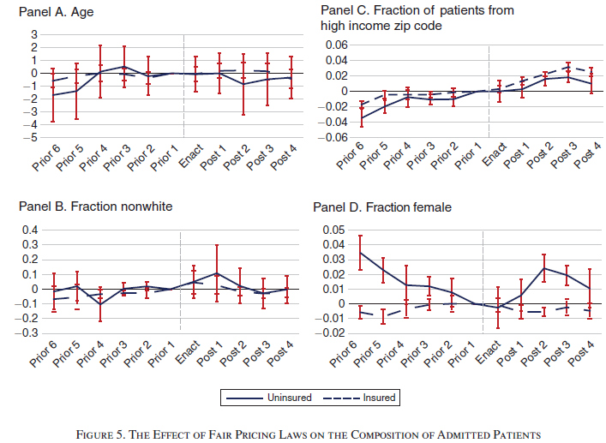
Fair Pricing Laws and Treatment Pattern
Notes:
There is a consistent small increase in patients from higher income zip codes in treated states, though the trend appears to predate FPLs and occurs both for insured and uninsured.
Finally, the fraction of female uninsured in treated states is somewhat noisy. We observe positive coefficients in a few post-years, though the same is true of most prior years as well

Slide 14
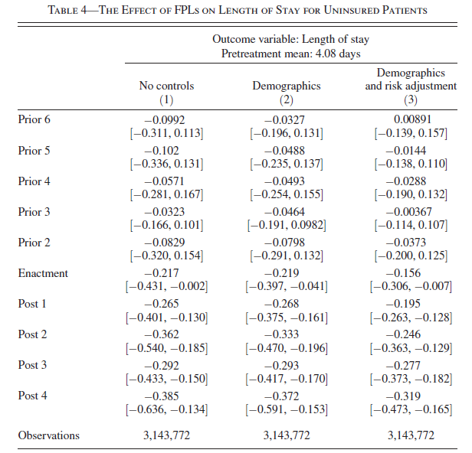
Fair Pricing Laws and Treatment Pattern
Notes:
Controlling for CCS still provides meaningful information about the severity of the
health condition, while also providing a buffer against the type of strategic diagnosing
described above.

Slide 15
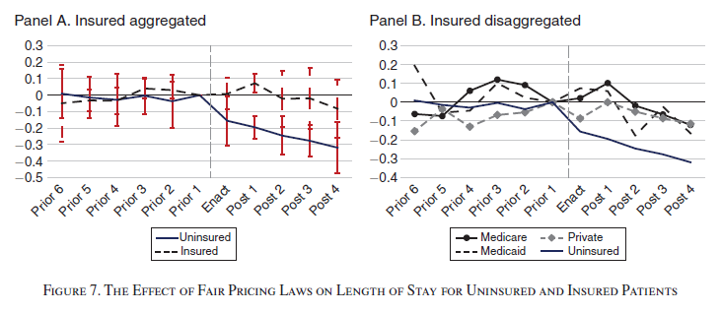
Fair Pricing Laws and Treatment Pattern
FPLs substantially reduce LOS for uninsured patients

Slide 16
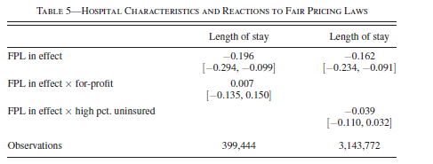
Fair Pricing Laws and Treatment Pattern
Whether certain types of hospitals respond more to FPLs?
Notes:
Column 1 of Table 5 reveals no evidence that for-profit hospitals shorten lengthsof stay for uninsured patients differently than do nonprofits. This is broadly consistent with prior work documenting limited differences between for- profit and nonprofit hospitals, such as in their provision of uncompensated care.
It is also easy to imagine that well-equipped hospitals that cater to more affluent patients would respond differently than safety-net hospitals. For example, safety-net hospitals may be under greater resource strain due to FPLs, though it’s possible they placed less emphasis on extracting revenue from the uninsured prior to FPLs. We proxy these differences by splitting the sample of hospitals based upon the fraction of their patients that are uninsured.
Column 2 of Table 5 shows no clear evidence that treating more uninsured patients elicits a stronger reaction to these laws.

Slide 17
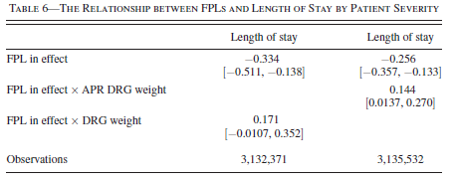
Fair Pricing Laws and Treatment Pattern
Where Do Hospitals Reduce Care (Patients)?
Notes:
suggest that FPLs induce hospitals to cut back care more for less severe patients
Traditional DRGs were designed for the Medicare population, and thus do not include as much granularity for some conditions, such as those related to maternity
for All Payer Refined (APR) DRGs, which are designed for an “all payer” population, and thus include more severity levels within a CCS for a wider variety of conditions.

Slide 18
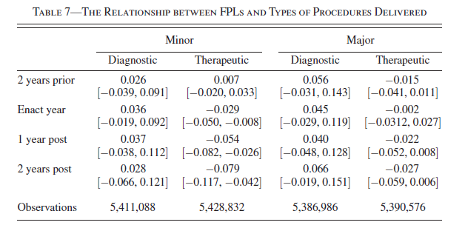
Fair Pricing Laws and Treatment Pattern
Where Do Hospitals Reduce Care (Services)?
Notes:
care reductions are concentrated in minor therapeutic procedures. suggesting that hospitals are more actively
targeting resources to the sicker patients. Consistent with our expectations, this evidence
shows that hospitals reduce care where it will likely have the least negative
effects.

Slide 19
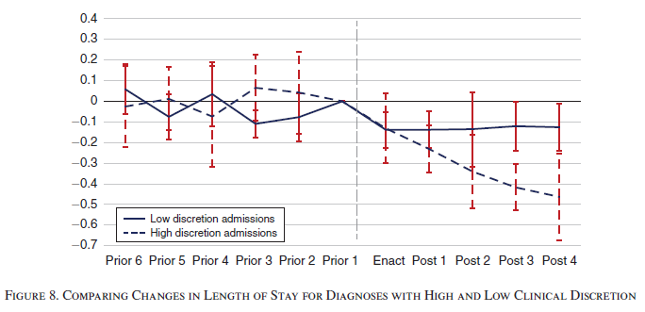
Fair Pricing Laws and Treatment Pattern
Where Do Hospitals Reduce Care (Diagnosis)?
Notes:
Finally, we would expect hospitals to reduce care where they have more clinical discretion or flexibility to do so.
One way to proxy for this discretion is through
within- diagnosis variation in length of stay. Diagnoses with high variation in length of stay likely represent those with more variation in treatment patterns, some of which generate considerably shorter stays. Those with low variation likely represent diagnoses with less latitude to alter treatment paths.

Slide 20
Fair Pricing Laws and Quality of Care
Outcome measures
Short-Term
Inpatient Quality Indicators (QI)
Mortality from selected conditions and procedures
Use of procedures believed to reduce mortality
Incidence of potentially preventable in-hospital complications
Long-Term
30-day all-cause readmission

Slide 21
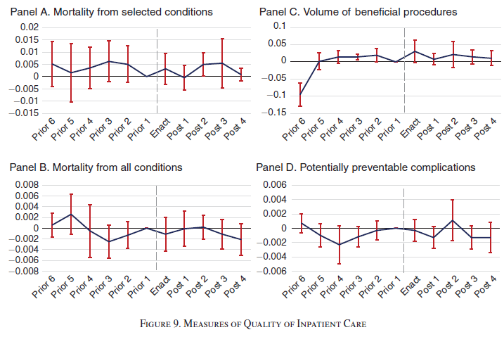
Fair Pricing Laws and Quality of Care
Short-Term
Notes:
selected 13 conditions and procedures where evidence indicates that mortality rates vary significantly among hospitals
our data fail to reveal clear signs of deterioration of short- term care quality after enactment of a fair pricing law.

Slide 22
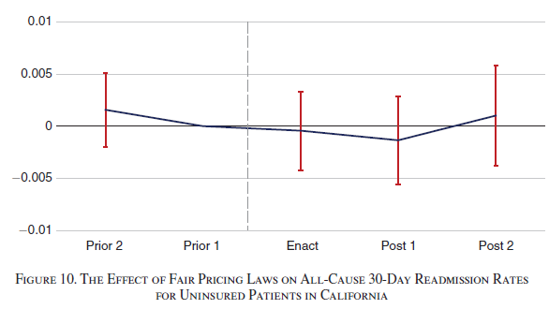
Fair Pricing Laws and Quality of Care
Long-Term
No evidence shows reduce in quality of care

Slide 23
Conclusion and discussion
FPLs reduced payment, quantity of care, while no evidence on reduce in quality.
FPLs improved consumer welfare and pushed the market closer towards an efficient outcome
Where hospitals can generate more efficient care.

Slide 24
Reflections
Comparison group(s)
Event study
Did the policy change the outcomes or the population composition?
LOS: Place of discharge
How to better document payment from uninsured patients? (hospital financial data)

